Slide 1
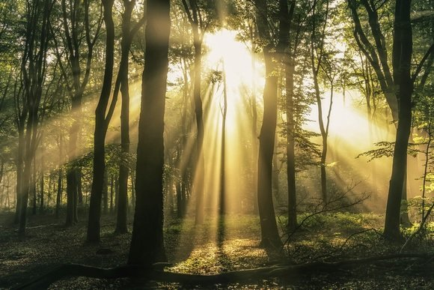
The Sixth Sunday after
Pentecost
July 9, 2023

Slide 2
Welcome and Announcements
Please let us know you are worshiping with us today by filling out the Worship card in your bulletin or using the form under the ‘Worship’ tab @ calvarylutheranscottsbluff.org

Slide 3
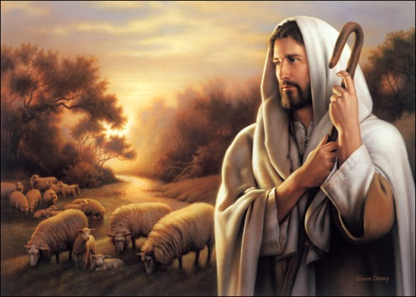
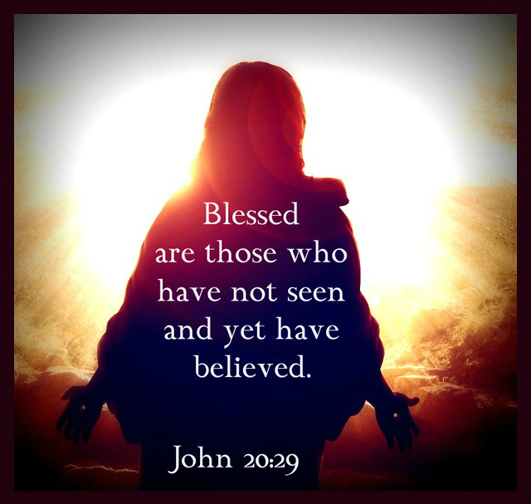
BECAUSE OF OUR RELATIONSHIP
WITH JESUS
Matthew 11:16-19, 25-30
☩ WE PREPARE OUR HEARTS ☩

Slide 4
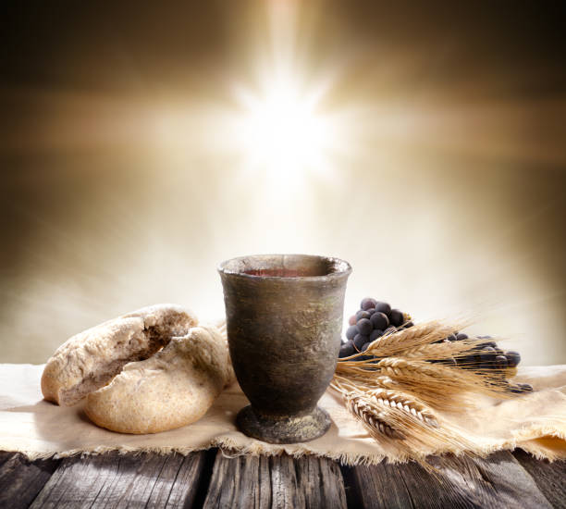
Distribution Song:
“Give Me Jesus”
ELW #770 vv. 1,3&5
“Give Me Jesus” African American spiritual
OneLicense.net A-705226

Slide 5
1. In the morning when I rise,
in the morning when I rise,
in the morning when I rise,
give me Jesus.

Slide 6
Refrain:
Give me Jesus,
give me Jesus.
You may have all the rest,
give me Jesus.

Slide 7
3. Just about the break of day,
just about the break of day,
just about the break of day,
give me Jesus.

Slide 8
Refrain:
Give me Jesus,
give me Jesus.
You may have all the rest,
give me Jesus.

Slide 9
5. And when I want to sing,
and when I want to sing,
and when I want to sing,
give me Jesus.

Slide 10
Refrain:
Give me Jesus,
give me Jesus.
You may have all the rest,
give me Jesus.

Slide 11
*Confession of Sins and Assurance of God’s Forgiveness
(All may make the sign of the cross ☩ the sign marked at baptism,
as we begin)

Slide 12
Blessed be the holy Trinity,☩ one God, who greets us in this and every season, whose word never fails, whose promise is sure. Amen.

Slide 13
Let us confess our sin in the presence of God and of our neighbors.

Slide 14
Merciful God,
we confess that we have sinned. We have hurt our community. We have squandered your blessings. We have hoarded your bounty. In the name of Jesus, forgive us and grant us your mercy.

Slide 15
(Silence is kept for reflection.)

Slide 16
Righteous God,
we confess that we have sinned. We have failed to be honest. We have lacked the courage to speak. We have spoken falsely. In the name of Jesus, forgive us and grant us your mercy.

Slide 17
(Silence is kept for reflection.)

Slide 18
God is a cup of cold water when we thirst. God offers boundless grace when we fail. Claim the gift of God’s mercy: you are freed and forgiven in the name of ☩ Jesus Christ.
Amen.

Slide 19
(Silence for reflection and self-examination)

Slide 20
*Song of Praise
“Awesome God”
W&P #13
“Awesome God” by Rich Mullins
CCLI License #1825044

Slide 21
Our God is an awesome God,
He reigns from heaven above
With wisdom, pow'r, and love
Our God is an awesome God!
Repeat
Our God is an awesome God!
Our God is an awesome God!

Slide 22
*Greeting
The grace of our risen Lord Jesus Christ, the love of God and the communion of the Holy Spirit be with you all.
And also with you.

Slide 23
*Prayer of the Day
You are great, O God,
and greatly to be praised. You have made us for yourself, and our hearts are restless until they rest in you.

Slide 24
Grant that we may believe in you, call upon you, know you, and serve you, through your Son, Jesus Christ, our Savior and Lord.
Amen.

Slide 25
BECAUSE OF OUR RELATIONSHIP
WITH JESUS
Matthew 11:16-19, 25-30
☩ GOD’S WORD SPEAKS TO US ☩

Slide 26
First Reading:
Zechariah 9:9-12

Slide 27
⁹Rejoice greatly, O daughter Zion! Shout aloud, O daughter Jerusalem! Lo, your king comes to you; triumphant and victorious is he, humble and riding on a donkey, on a colt, the foal of a donkey.

Slide 28
¹⁰He will cut off the chariot from Ephraim and the war-horse from Jerusalem; and the battle bow shall be cut off, and he shall command peace to the nations; his dominion shall be from sea to sea, and from the River to the ends of the earth.

Slide 29
¹¹As for you also, because of the blood of my covenant with you, I will set your prisoners free from the waterless pit. ¹²Return to your stronghold, O prisoners of hope; today I declare that I will restore to you double.

Slide 30
The Word of the Lord.
Thanks be to God.

Slide 31
Psalm 145:8-14

Slide 32
⁸The Lord is gracious and full of compassion, slow to anger and abounding in steadfast love. ⁹Lord, you are good to all, and your compassion is over all your works.

Slide 33
¹⁰All your works shall praise you, O Lord, and your faithful ones shall bless you. ¹¹They shall tell of the glory of your kingdom and speak of your power,

Slide 34
¹²that all people may know of your power and the glorious splendor of your kingdom. ¹³Your kingdom is an everlasting kingdom; your dominion endures throughout all ages. You, Lord, are faithful in all your words, and loving in all your works.

Slide 35
¹⁴The Lord upholds all those who fall and lifts up those who are bowed down.

Slide 36
Second Reading: Romans 7:15-25a

Slide 37
¹⁵I do not understand my own actions. For I do not do what I want, but I do the very thing I hate. ¹⁶Now if I do what I do not want, I agree that the law is good. ¹⁷But in fact it is no longer I that do it, but sin that dwells within me.

Slide 38
¹⁸For I know that nothing good dwells within me, that is, in my flesh. I can will what is right, but I cannot do it. ¹⁹For I do not do the good I want, but the evil I do not want is what I do. ²⁰Now if I do what I do not want, it is no longer I that do it, but sin that dwells within me.

Slide 39
²¹So I find it to be a law that when I want to do what is good, evil lies close at hand. ²²For I delight in the law of God in my inmost self, ²³but I see in my members another law at war with the law of my mind, making me captive to the law of sin that dwells in my members.

Slide 40
²⁴Wretched man that I am! Who will rescue me from this body of death? ²⁵Thanks be to God through Jesus Christ our Lord!

Slide 41
The Word of the Lord.
Thanks be to God.

Slide 42
*Gospel Verse
Page 142
Alleluia. Lord,
to whom shall we go?
You have the words of eternal life.
Alleluia. Alleluia.

Slide 43
*Gospel:
Matthew 11:16-19, 25-30

Slide 44
Response after the announcement
of the gospel:
Glory to you,
O Lord.

Slide 45
¹⁶But to what will I compare this generation? It is like children sitting in the marketplaces and calling to one another, ¹⁷'We played the flute for you, and you did not dance; we wailed, and you did not mourn.'

Slide 46
¹⁸For John came neither eating nor drinking, and they say, 'He has a demon'; ¹⁹the Son of Man came eating and drinking, and they say, 'Look, a glutton and a drunkard, a friend of tax collectors and sinners!' Yet wisdom is vindicated by her deeds."

Slide 47
²⁵At that time Jesus said, "I thank you, Father, Lord of heaven and earth, because you have hidden these things from the wise and the intelligent and have revealed them to infants; ²⁶yes, Father, for such was your gracious will.

Slide 48
²⁷All things have been handed over to me by my Father; and no one knows the Son except the Father, and no one knows the Father except the Son and anyone to whom the Son chooses to reveal him.

Slide 49
²⁸Come to me, all you that are weary and are carrying heavy burdens, and I will give you rest. ²⁹Take my yoke upon you, and learn from me; for I am gentle and humble in heart, and you will find rest for your souls. ³⁰For my yoke is easy, and my burden is light."

Slide 50
Response after the gospel reading:
Praise to you, O Christ.

Slide 51
Kid’s Sermon:
Angie Hinze

Slide 52
Sermon
PMA Maurine Roller

Slide 53
(Silence for
Reflection and Meditation.)

Slide 54
BECAUSE OF OUR RELATIONSHIP
BECAUSE OF OUR RELATIONSHIP
WITH JESUS
Matthew 11:16-19, 25-30
☩WE RESPOND TO GOD’S WORD☩

Slide 55
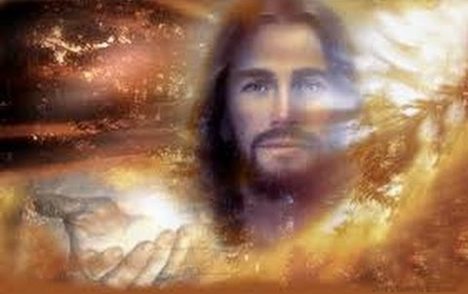
Hymn of the Day:
“Softly and Tenderly Jesus Is Calling”
ELW #608
“Softly and Tenderly Jesus Is Calling” by Will L. Thompson ©Public Domain

Slide 56
1. Softly and tenderly Jesus is calling,
calling for you and for me.
See, on the portals he's waiting and watching,
watching for you and for me.
Notes:
Image: Transfiguration by Kathrin Burleson. Copyright © Kathrin Burleson. All rights reserved. Used by permission of the artist.

Slide 57
Refrain
"Come home, (Come home,)
come home! (come home!)
You who are weary, come home."
Earnestly, tenderly, Jesus is calling,
calling, "O sinner, come home!"
Notes:
Image: Transfiguration by Kathrin Burleson. Copyright © Kathrin Burleson. All rights reserved. Used by permission of the artist.

Slide 58
2. Why should we tarry when Jesus is pleading,
pleading for you and for me?
Why should we linger and heed not his mercies,
mercies for you and for me?
Notes:
Image: Transfiguration by Kathrin Burleson. Copyright © Kathrin Burleson. All rights reserved. Used by permission of the artist.

Slide 59
Refrain
"Come home, (Come home,)
come home! (come home!)
You who are weary, come home."
Earnestly, tenderly, Jesus is calling,
calling, "O sinner, come home!"
Notes:
Image: Transfiguration by Kathrin Burleson. Copyright © Kathrin Burleson. All rights reserved. Used by permission of the artist.

Slide 60
3. Oh, for the wonderful love he has promised,
promised for you and for me!
Though we have sinned, he has mercy and pardon,
pardon for you and for me.
Notes:
Image: Transfiguration by Kathrin Burleson. Copyright © Kathrin Burleson. All rights reserved. Used by permission of the artist.

Slide 61
Refrain
"Come home, (Come home,)
come home! (come home!)
You who are weary, come home."
Earnestly, tenderly, Jesus is calling,
calling, "O sinner, come home!"
Notes:
Image: Transfiguration by Kathrin Burleson. Copyright © Kathrin Burleson. All rights reserved. Used by permission of the artist.

Slide 62
*Profession of Faith:
The Apostles Creed
I believe in God,
the Father almighty,
creator of heaven
and earth.

Slide 63
I believe in Jesus Christ,
God's only Son, our Lord,
who was conceived
by the Holy Spirit,
born of the virgin Mary,
suffered under Pontius Pilate,
was crucified, died,
and was buried;
he descended to the dead.

Slide 64
On the third day he rose again;
he ascended into heaven,
he is seated at the right hand
of the Father,
and he will come to judge the
living and the dead.

Slide 65
I believe in the Holy Spirit,
the holy catholic church,
the communion of saints,
the forgiveness of sins,
the resurrection of the body,
and the life everlasting.
Amen.

Slide 66
*Prayers of the Church:
Each petition ends with:
Hear us, O God, … your mercy is great.
The prayers conclude:
….in the name of Jesus Christ our Savior. Amen.

Slide 67
*Sharing of the Peace
The peace of the Lord be with you always.
And also with you.

Slide 68
Offering

Slide 69
*Offertory Prayer
God of field and forest, sea and sky,
you are the giver of all good things.

Slide 70
Sustain us with these gifts of your creation, and multiply your graciousness in us, that the world may be fed with your love, through Jesus Christ, our Savior and Lord. Amen.

Slide 71
*Thanksgiving for the Word ELW pg 220
Let us pray.

Slide 72
Praise and thanks to you, holy God, for by your Word you made all things: you spoke light into darkness, called forth beauty from chaos, and brought life into being. For your Word of life, O God,
we give you thanks and praise.

Slide 73
By your Word you called your people Israel to tell of your wonderful gifts: freedom from captivity, water on the desert journey, a pathway home from exile, wisdom for life with you. For your Word of life, O God,
we give you thanks and praise.

Slide 74
Through Jesus, your Word made flesh, you speak to us and call us to witness: forgiveness through the cross, life to those emtombed by death, the way of your self-giving love. For your Word of life, O God,
we give you thanks and praise.

Slide 75
Send your spirit of truth, O God; rekindle your gifts within us: renew our faith, increase our hope, and deepen our love, for the sake of a world in need.

Slide 76
Faithful to your Word, O God, draw near to all who call on you; through Jesus Christ, our Savior and Lord, to whom, with you and the Holy Spirit, be honor and glory forever.
Amen.

Slide 77
The Lord’s Prayer
Our Father, who art in heaven,
hallowed be thy name,
thy kingdom come,
thy will be done,
on earth as it is in heaven.

Slide 78
Give us this day
our daily bread;
and forgive us our trespasses,
as we forgive those
who trespass against us;

Slide 79
and lead us not into temptation,
but deliver us from evil.
For thine is the kingdom,
and the power, and the glory, forever, and ever. Amen.

Slide 80
BECAUSE OF OUR RELATIONSHIP
WITH JESUS
Matthew 11:16-19, 25-30
☩WE DEPART TO SERVE☩

Slide 81
*Benediction
The God who calls across the cosmos and speaks in the smallest seed ☩ bless, keep, and sustain you now and to the end of the age.
Amen.

Slide 82
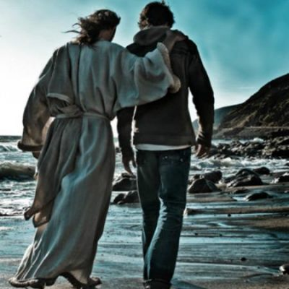
* Sending Hymn:
“Just a Closer Walk with Thee”
ELW #697
“Just a Closer Walk with Thee” North American Traditional ©Public Domain

Slide 83
Refrain
Just a closer walk with thee,
grant it, Jesus, is my plea;
daily walking close to thee,
let it be, dear Lord, let it be.

Slide 84
1. I am weak but thou art strong:
Jesus, keep me from all wrong;
I'll be satisfied as long
as I walk, let me walk close to thee.

Slide 85
Refrain
Just a closer walk with thee,
grant it, Jesus, is my plea;
daily walking close to thee,
let it be, dear Lord, let it be.

Slide 86
2. Through this world of toil and snares,
if I falter, Lord, who cares?
Who with me my burden shares?
None but thee, dear Lord, none but thee.

Slide 87
Refrain
Just a closer walk with thee,
grant it, Jesus, is my plea;
daily walking close to thee,
let it be, dear Lord, let it be.

Slide 88
3. When my feeble life is o'er,
time for me will be no more;
guide me gently, safely o'er
to thy kingdom shore, to thy shore.

Slide 89
Refrain
Just a closer walk with thee,
grant it, Jesus, is my plea;
daily walking close to thee,
let it be, dear Lord, let it be.

Slide 90
*Dismissal
Go in peace. Share the harvest.
Thanks be to God.

